Slide 1

Welcome to CS!!!
Recitation 1

Slide 2

Who am I?
Hey, I’m Sujit!
Year: Sophomore
Major: Computer Science
Minor: IDK!!!
Email: sujit.molleti@rutgers.edu
Hobbies: Running, Sports, Trying to Read, YouTube

Slide 3
Who are you?
What is your name?
What is your major?
What is/are your goal(s) for this course?
What is your dream job(Not CS)?

Slide 4
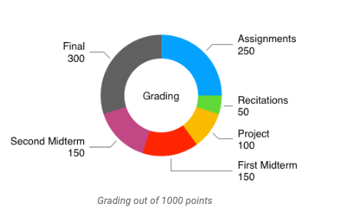
Grading Scheme
There is NO CURVE!!!
A >= 900
900 > B+ >= 850
850 > B >= 800
800 > C+ >= 750
750 > C >= 700
700 > D >= 600
600 > F

Slide 5
Recitations
5% of your overall grade (Mandatory)
80% is showing up
20% is the quiz
2-3 problems from dynrec
10 for 10
10 minutes to solve
10 minutes to review

Slide 6
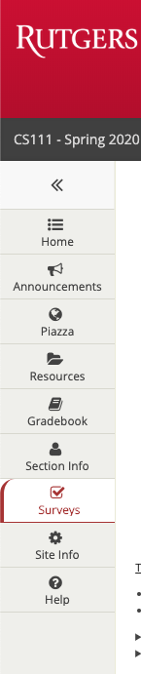
Extra Credit
Two Surveys (2.5 points each) = 0.05%
Entry
Exit
There are no other extra credit assignments
No Bump-ups

Slide 7
Review: Pseudocode
Commands: IF/ELSE, HALT, READ, COMPUTE, DISPLAY
Pseudocode makes it easy to write algorithms
Programming is a skill, not a talent!
Do NOT let your grade define you!

Slide 8
Example: NESTED Statements
READ STATE
READ COUNTRY
READ

